Slide 1
Lead Score Case Study
Lisna Paleri
Nishant kumar
Vaishnavi Kura

Slide 2
Problem Statement
X Education is a company that offers online courses to industry experts, X Education wishes to identify the most promising leads, which can be converted into paying customers.
Although the organization generates a large number of leads, only a small percentage of them are converted into paying clients. Throughout the entire process of converting leads to clients, the company had a 30% conversion rate.
Business Goal
X Education needs help in selecting the most promising leads.
The company requires a model in which a lead score is assigned to each lead, with higher lead scores having a higher conversion chance and lower lead scores having a lower conversion chance.

Slide 3
Strategy
Source the data for analysis.
Clean and prepare the data for further analysis.
Exploratory Data Analysis for figuring out most helpful attributes for conversion.
Scaling features.
Splitting the data into Train and Test dataset.
Building a Logistic Regression model and calculate lead score.
Evaluating the model by using different metrics- Specificity and Sensitivity or Precision and Recall.
Apply the best model in test data based on the Specificity and Sensitivity metrics.

Slide 4
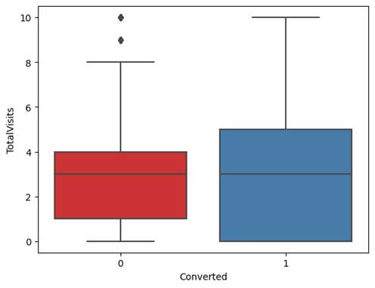
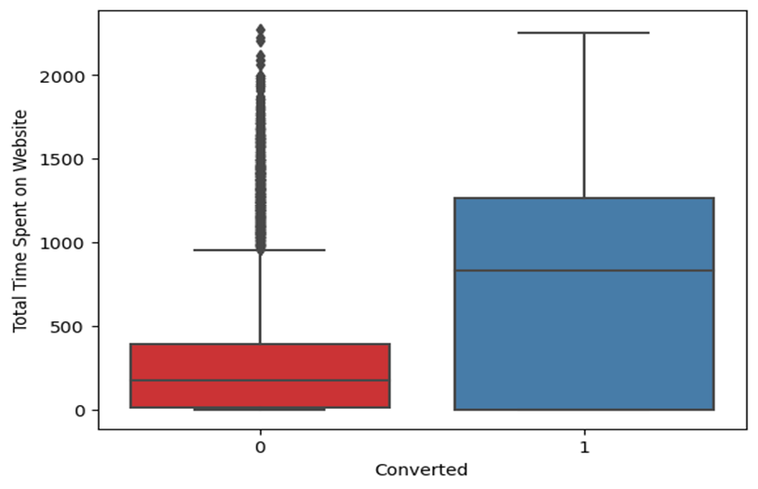
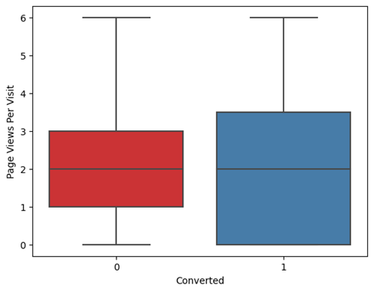
Exploratory Data Analysis
The median for both converted and non converted rate is same for Total visits and page views per visit.
The conversion rate is high for Total time spent on website

Slide 5
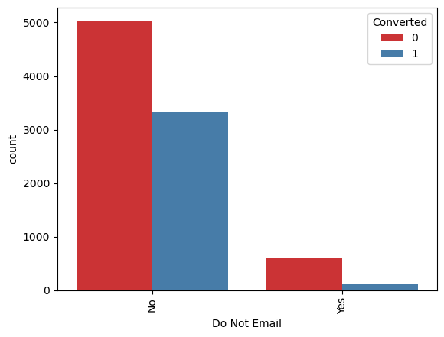
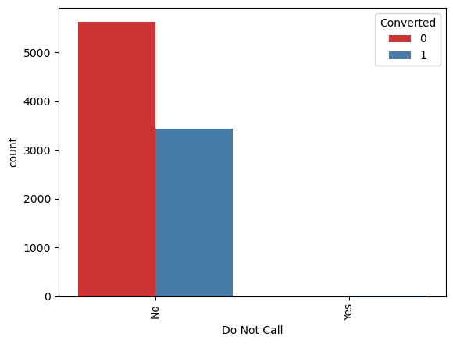
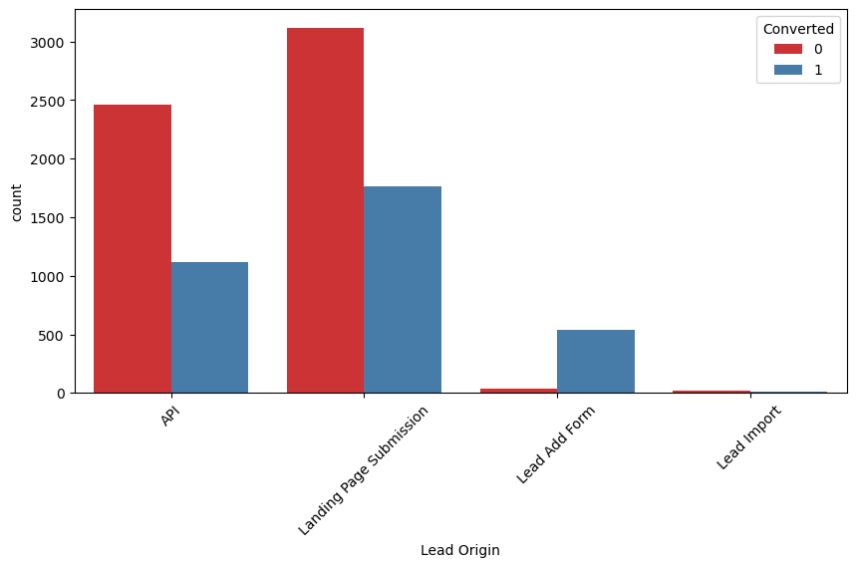
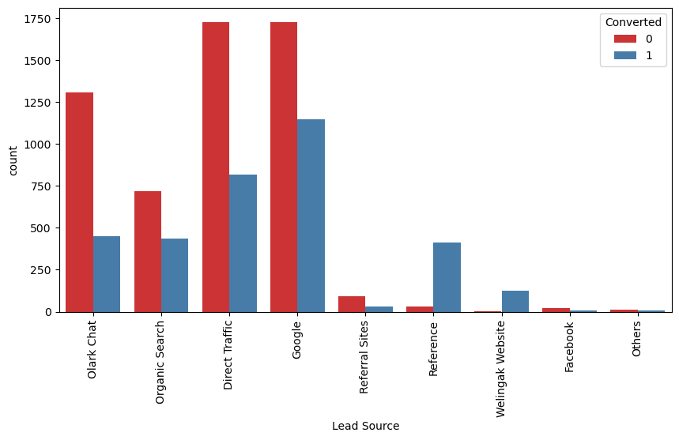
In Lead origin maximum conversion happened from Landing page submission
Major conversion happened from Emails sent and calls made.
Major conversion in the lead source is from google

Slide 6
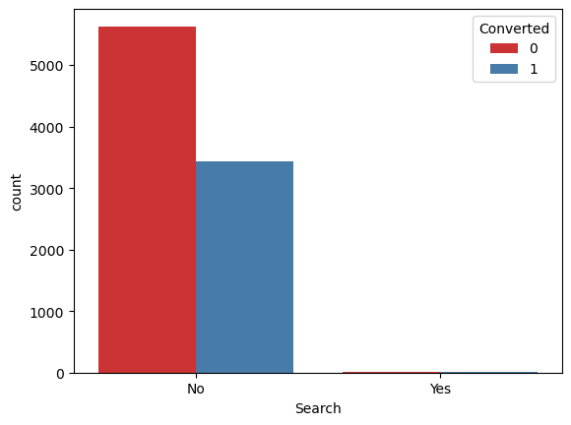
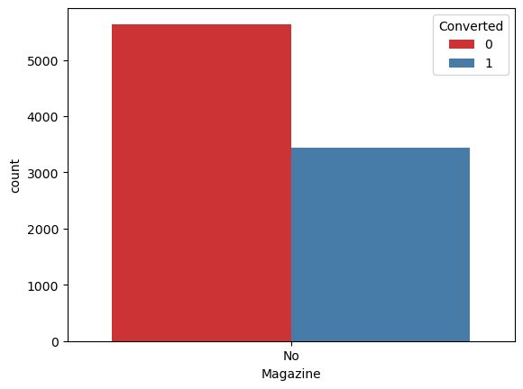
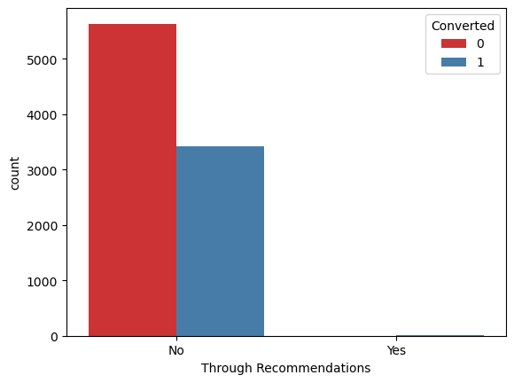
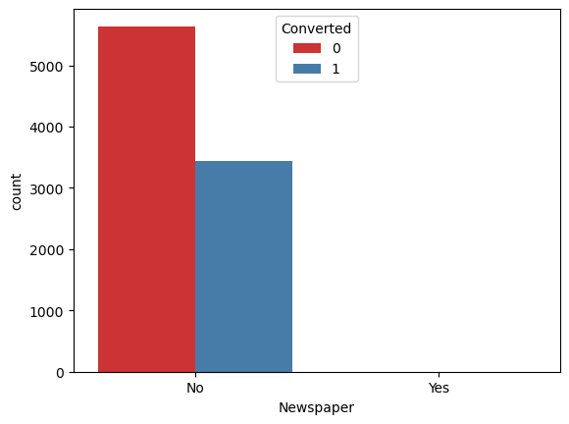
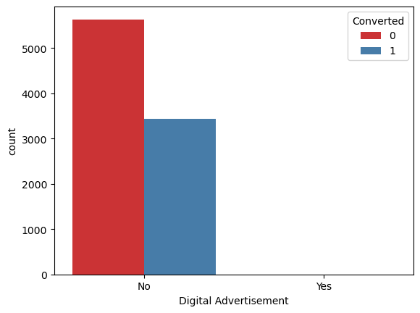
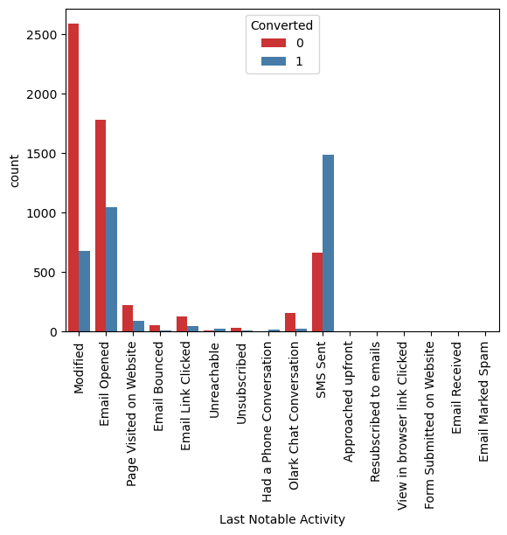
Not much impact on conversion rates through Search, Magazine, Through Recommendations, Newspaper, Digital Advertisement
Last Activity value of SMS sent had more conversion

Slide 7
Variables impacting the conversion rate
Lead source walking website
Lead source reference
What is your current occupation- working professional
Last activity- other activity
Last activity- SMS sent
Total time spend o website
Lead source olark chat
Last notable activity-modified
Last Activity – Olark Chat Conversation
Lead origin landing page submission
Specialization others
Do not Email

Slide 8
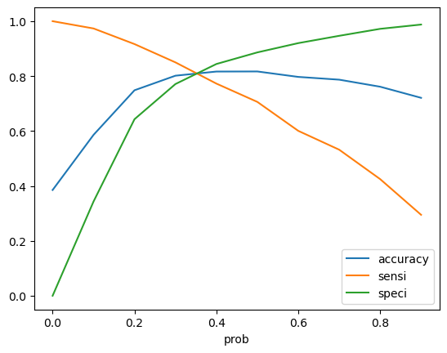
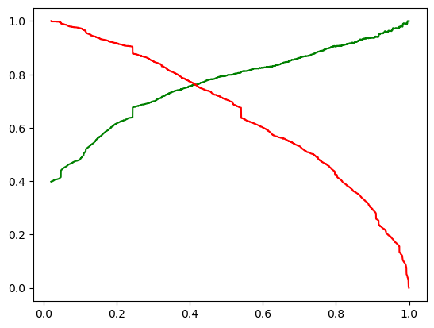
Model Evaluation(Train)
Accuracy, Sensitivity and Specificity
Accuracy : 81%
3461
444
Sensitivity : 81.7%
719
1727
Specificity : 80.6%
Precision and Recall
Precision : 79%
Recall : 70%

Slide 9
Model Evaluation on Test dataset
Confusion Matrix
• Accuracy – 80.4 %
• Sensitivity – 80.4 %
• Specificity – 80.5%
1396
338
193
796

Slide 10
Conclusion
EDA
People that spending more time on website are likely to convert, thus targeting and approaching them can be beneficial.
SMS messages have a significant impact on lead conversion.
Landing page submissions can help find out more leads.
The company try to call the working professionals since they are more likely to convert.
Welingak Websites and references might be a valuable source of conversion.
Logistic Regression model
The model has an accuracy of 80.4%.
The model has a sensitivity of 80.4% and a specificity of 80.5%.
The model identifies both potential leads and leads with low conversion rates.
As a result, this model appears to be good overall.

